Slide 1
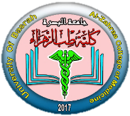
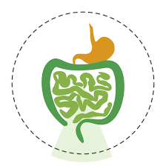
University of Basrah Al-zahraa medical college
Ministry of higher Education and Scientific Research
Module: Gastro-Intestinal Tract (GIT)
Semester: 4 Session: 8 Lecture 2
Lecture Title: Absorption and Mobility in S/L Intestines
This Lecture was prepared by module staff:
Dr. Sadik Hassan
Dr. Wisam Hamza
Dr. Jawad Ramadan Dr. Haithem Almoamen
Dr. Nawal Mustafa
Dr. Haider Mohssen
Dr. Maida Abdulla
Dr. Talal Hadi
Dr. Amani Naama Dr. Ilham Mohammed
Dr. Farqad Alhamdani Dr. Zainab Ahmed
Dr. Ansam Munadhel
Dr. Nehaya Mnahi Dr. Hameed Abbas Ban Mohammed
Dr. Mustafa Ghazi
Dr. Ahmed Jalil
This Lecture was loaded in blackboard and you can find the material
Guyton and Hall physiology text book 2016, Vander s Human physiology 13 ed;
Gastrointestinal system – crash course. 3rd Edition, Mosby [2008]
For more detailed instructions, any question, or you have a case you need help in,
please post to the group of session. Images are under Creative Commons Distribution.

Slide 2
Learning Objectives:
1. Describe the gross & microscopic anatomy of the small and large intestines and relate these to their function
2. Outline the functions of the different parts of the bowel
3. Describe the mechanisms of absorption of the following groups of nutrients in the small intestine:
a. Sugars b. Amino acids
c. Fats d. Salts and water
4. Describe the basis of oral rehydration therapy
5. Describe the patterns of motility of the small intestine
6. Describe the functions of the large intestine
7. Describe the motility of the colon and rectum
8. Describe the mechanisms of defecation

Slide 3
University of Basrah Al-zahraa medical college
Ministry of higher Education and Scientific Research
*Gross Anatomy of The Small Intestine:
LO1
Is the primary digestive organ, also where practically all absorption occurs.
The longest part of the alimentary canal, about 3-6m long.
Its name related to smaller diameter of about 2.54 cm, compared with 7.62 cm for the large intestine.
Enormous internal surface area??? Importance???

Slide 4
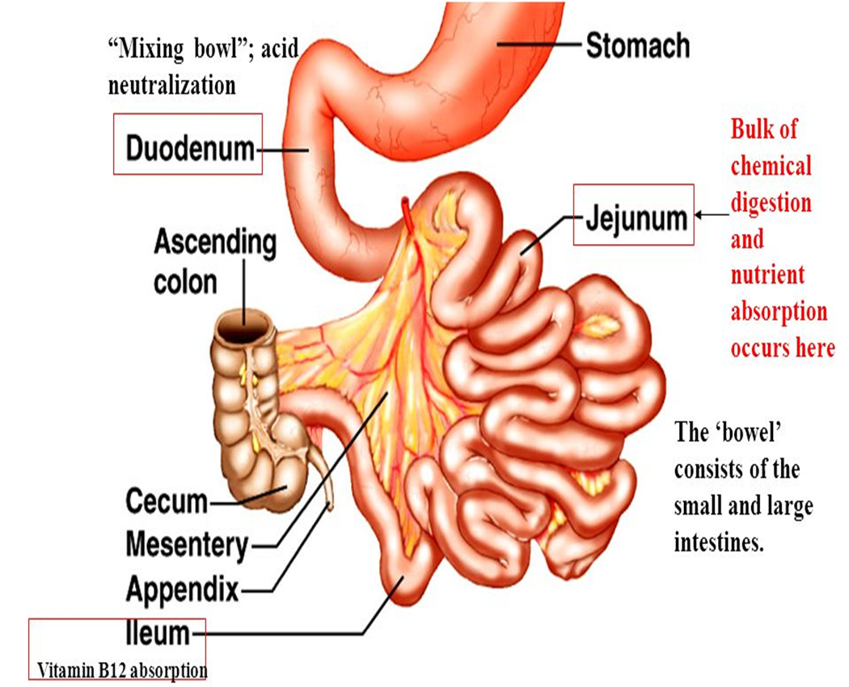
University of Basrah Al-zahraa medical college
Ministry of higher Education and Scientific Research
Parts of Small Intestine
LO1
From the pyloric sphincter to the ileo-cecal valve.
Three subdivisions which are defined by the distinctive features of the mucosa:
1- Duodenum
2- Jejunum
3- Ileum
Notes:
The jejunum:
No clear demarcation exists between the jejunum and the ileum.
Specialized for absorption.
*The ileum:
The longest part of the small intestine.
It is thicker, more vascular than the jejunum.
The ileum joins the cecum, the first portion of the large intestine, at the ileocecal sphincter (or valve).

Slide 5
University of Basrah Al-zahraa medical college
Ministry of higher Education and Scientific Research
LO1 & 2
Chyme delivered to the duodenum is hypertonic, acidic and only partly digested.
It is conditioned by osmotic movement of water, hepatic and biliary secretion of HCO3- and a cocktail of enzymes into a neutral isotonic solution which progresses slowly through the small intestine where most absorption takes place.

Slide 6
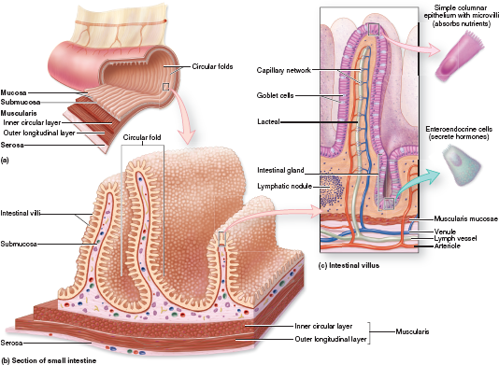
University of Basrah Al-zahraa medical college
Ministry of higher Education and Scientific Research
*Microscopic Anatomy of Small Intestine:
LO1
All the same four layers typically present in the alimentary system (mucosa ,sub mucosa, muscular layer and serosa)

Slide 7
University of Basrah Al-zahraa medical college
Ministry of higher Education and Scientific Research
Microscopic Anatomy of Small Intestine:
LO1&2
Three features of the mucosa and submucosa are unique and most abundant in the proximal two-thirds of the small intestine????
2- Villi Covered by mucosal epithelium, primarily absorptive.
Its structure supported by muscle, connective tissue and a capillary bed composed of one arteriole, one venule and a lymphatic capillary called a lacteal
3- micro-villi (brush boarder ) cover the luminal surface of the enterocytes
1- Circular folds (Plicae circulares) Their shape causes the chyme to spiral, rather than move in a straight line.
Provides the time needed for nutrients to be fully absorbed.
Notes:
Circular fold (Plicae circulares):
A deep ridge in the mucosa and submucosa.
Beginning near the proximal part of the duodenum and ending near the middle of the ileum
Villi:
Hair-like vascularized projections give the mucosa a furry texture ,to increase the surface area for absorption
The brush boarder forms an ‘unstirred layer’ where nutrients meet and react with enzymes secreted by the enterocytes so completing digestion prior to absorption.

Slide 8
University of Basrah Al-zahraa medical college
Ministry of higher Education and Scientific Research
LO1 & 2
Sugars and amino acids can enter the bloodstream directly.
Lipid breakdown products are absorbed by the lacteals.

Slide 9
University of Basrah Al-zahraa medical college
Ministry of higher Education and Scientific Research
LO1 & 2
Cell type | Location in the mucosa | Function
Absorptive enterocyte | Epithelium/intestinal glands | Digestion and absorption of nutrients in chyme
Goblet | Epithelium/intestinal glands | Secretion of mucus
Paneth | Intestinal glands | Secretion of the bactericidal enzyme lysozyme; phagocytosis
G cells | Intestinal glands of duodenum | Secretion of the hormone intestinal Gastrin
I cells | Intestinal glands of duodenum | Secretion of the hormone cholecystokinin, which stimulates release of pancreatic juices and bile
K cells | Intestinal glands | Secretion of the hormone glucose-dependent insulinotropic peptide, which stimulates the release of insulin
M cells | Intestinal glands of duodenum and jejunum | Secretion of the hormone Motilin, which accelerates gastric emptying, stimulates intestinal peristalsis, and stimulates the production of pepsin
S cells | Intestinal glands | Secretion of the hormone Secretin

Slide 10
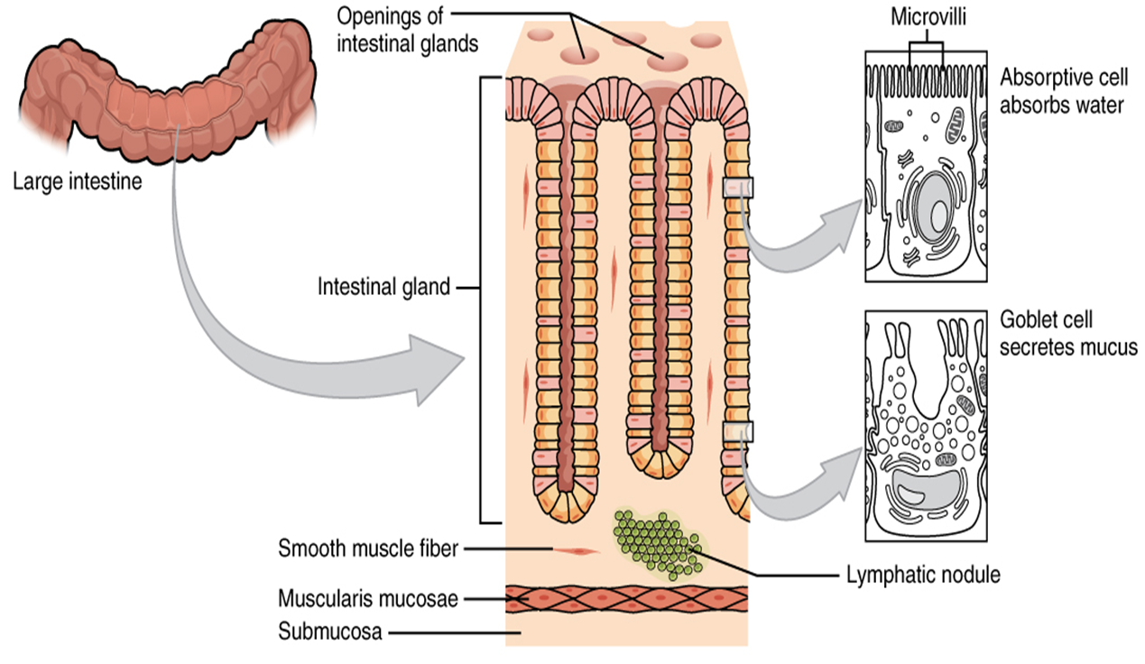
University of Basrah Al-zahraa medical college
Ministry of higher Education and Scientific Research
Microscopic Anatomy of large Intestine:
LO1
All 4 layers
Mucosa: simple columnar epithelium until anal canal (stratified squamous).
No folds or villi.
Few enzyme-secreting cells .
Crypts: invagination of mucosa contain large number of goblet cells that secrete mucous for lubrication and protection.

Slide 11
University of Basrah Al-zahraa medical college
Ministry of higher Education and Scientific Research
Bacterial flora:
Facilitate chemical digestion, and some synthesize certain vitamins as B complex, and vitamin K.
Some are linked to increased immune response.
Nonpathogenic as long as they stay in the gut lumen.
*Saccharolytic fermentation:
Break down some of the remaining carbohydrates.
Resulting in the discharge of hydrogen, carbon dioxide, and methane gases that create flatus (gas) in the colon.
LO1

Slide 12
University of Basrah Al-zahraa medical college
Ministry of higher Education and Scientific Research
LO3
Mechanisms of nutrients absorption in the small intestine:
90% of nutrients and water absorption occur in the small intestine.
Chemical digestion
food molecules hydrolysis monomeric forms that can be absorbed.
Notes:
Chemical digestion by catabolic break down of food molecules to monomeric forms that can be absorbed.
Enzymes break molecules by hydrolysis (adding H2O into a molecular bond).

Slide 13
University of Basrah Al-zahraa medical college
Ministry of higher Education and Scientific Research
a. Sugars:
All complex sugars are digested to disaccharides and then to monosaccharides (glucose, galactose, and fructose) by the brush border enzymes.
Only monosaccharides are able to be absorbed.
Absorbed by facilitated diffusion or secondary active transport
GLUT5 = fructose transporter
SGLT1 = sodium glucose transporter 1
GLUT2 = glucose transporter 2
LO3

Slide 14
University of Basrah Al-zahraa medical college
Ministry of higher Education and Scientific Research
Enzyme involved:
LO3
Salivary amylase: breaks starch into 2-8 linked monosaccharides.
(denatured by HCl in the stomach).
Pancreatic amylase: continues breakdown mostly to maltose.
Brush border enzymes: (sucrase, maltase, & lactase) breakdown sucrose, maltose, & lactose.
What is Lactose intolerance ?

Slide 15
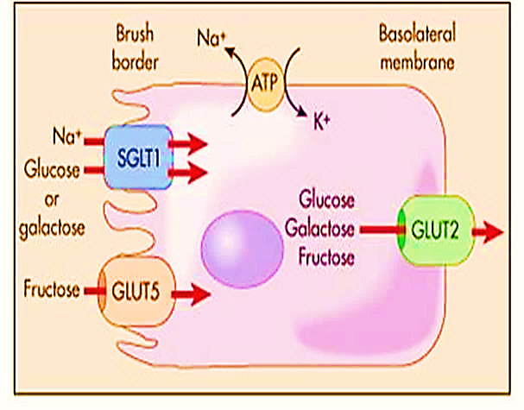
University of Basrah Al-zahraa medical college
Ministry of higher Education and Scientific Research
Sugars absorption
LO3

Slide 16
University of Basrah Al-zahraa medical college
Ministry of higher Education and Scientific Research
b. Amino acids:
LO3
Proteins are broken down to amino acid monomers.
1, 2, or 3 attached amino acids are able to cross the intestinal epithelial cells by co-transport with H+ or Na+ ions.
Enzymes involved: Begins in the stomach.
Pepsinogen is activated to pepsin by HCl.
Pepsin cleaves peptide bonds. Then is inactivated by increased pH in the duodenum.
Trypsin & chymotrypsin (pancreatic enzymes) further breakdown further polypeptide.
Brush border peptidases?????

Slide 17
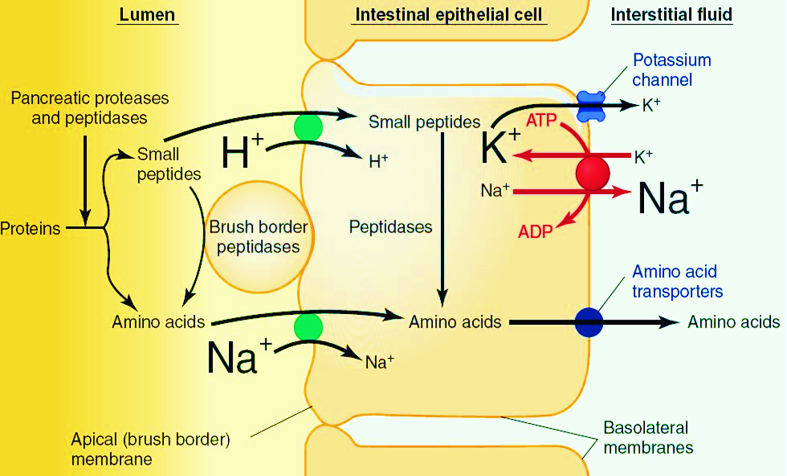
University of Basrah Al-zahraa medical college
Ministry of higher Education and Scientific Research
Amino acids absorption
LO3

Slide 18
University of Basrah Al-zahraa medical college
Ministry of higher Education and Scientific Research
c. Fats:
LO3
Fats (triglycerides) are cleaved by pancreatic lipase into monoglycerides and 2 free fatty acids
Free Fatty acids, monoglycerides and fat soluble vitamins (A,K,E,D) are emulsified by attachment to bile salt to form micelles
Once micelles on brush border, the fatty acids are freed rapidly from bile salts
Enter into intestinal epithelial cells by diffusion, again reassembled into triglycerides
In endoplasmic reticulum, triglyceride combine with proteins to form chylomicron
Chylomicrons diffuse out from intestinal epithelium to enter lacteals

Slide 19
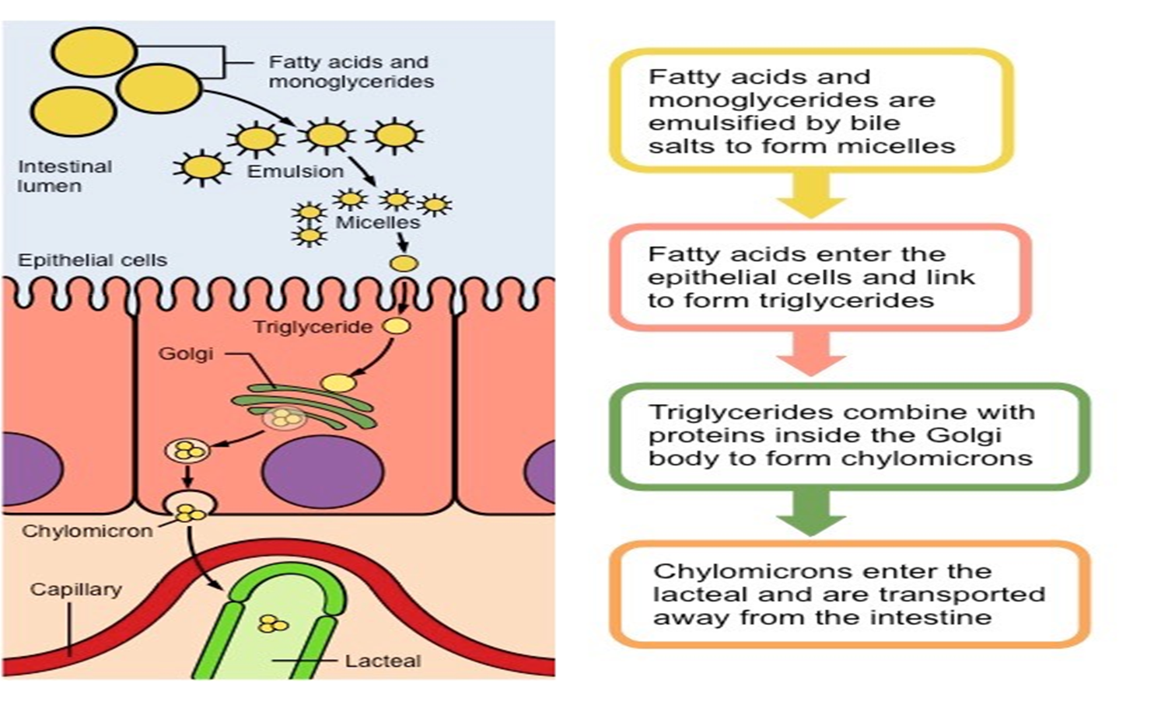
University of Basrah Al-zahraa medical college
Ministry of higher Education and Scientific Research
Lipid absorption
LO3

Slide 20
University of Basrah Al-zahraa medical college
Ministry of higher Education and Scientific Research
LO3
Bile salts absorption is in terminal ilium.
Normally all ingested fats are absorbed.
Fat in stool = steatorrhea = small intestine diarrhea

Slide 21
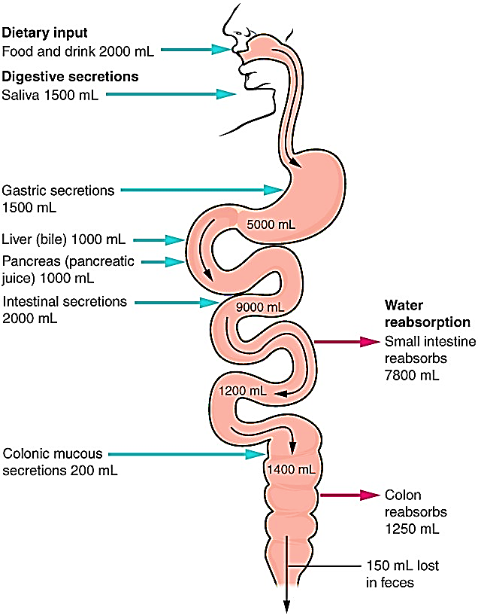
University of Basrah Al-zahraa medical college
Ministry of higher Education and Scientific Research
c. Salts and Water:
LO3

Slide 22
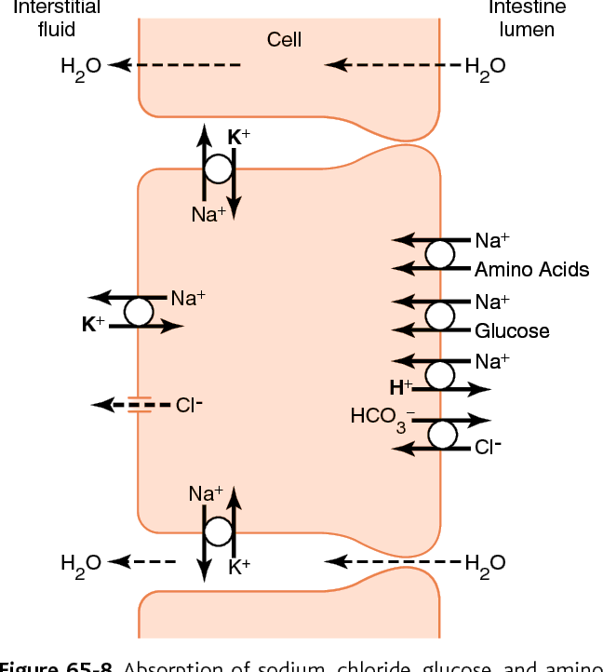
University of Basrah Al-zahraa medical college
Ministry of higher Education and Scientific Research
Water:
Moves freely in both directions across the mucosa.
Active transport of solutes create an osmotic gradients and water follows by osmosis.
LO3

Slide 23
University of Basrah Al-zahraa medical college
Ministry of higher Education and Scientific Research
Electrolytes:
Most ions are actively absorbed throughout the small intestine
Na+ is coupled to absorption of glucose and amino acids (cotransport)
Cl¯ is actively transported into cells, and exchange for HCO3¯.
Ca++ absorption is regulated by blood Ca++ levels and Vit. D ( Vit. D is a required cofactor for Ca++ absorption).
Iron is transported into the cells and bound to ferritin. Main absorption site is duodenum.
LO3

Slide 24
University of Basrah Al-zahraa medical college
Ministry of higher Education and Scientific Research
B12 (Cobalamine) absorption
LO3
In duodenum, B12 bind to Intrinsic factor which is secreted from Parietal cell in the stomach.
B12-Intrinsic factor complex recognized and absorbed by receptors in terminal ileum epithelium.
From epithelium to portal circulation where it bind to Transcobalamine II and transported to liver where it stored……
Pernicious anemia???
Increase need???

Slide 25
University of Basrah Al-zahraa medical college
Ministry of higher Education and Scientific Research
LO4
The basis of oral rehydration therapy
Oral rehydration therapy (ORT)
Is fluid replacement used to prevent and treat dehydration, especially that due to diarrhea.
It involves drinking water with modest amounts of sugar and salts, specifically sodium and potassium.
ORT can also be given by a nasogastric tube.
Zinc supplement????
Played an important role in reducing the number of deaths in children under the age of five

Slide 26
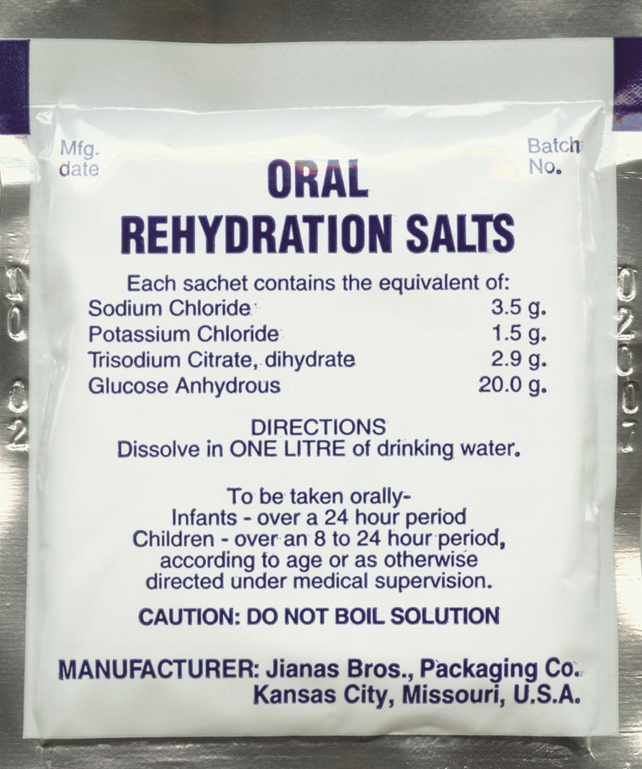
University of Basrah Al-zahraa medical college
Ministry of higher Education and Scientific Research
LO4

Slide 27
University of Basrah Al-zahraa medical college
Ministry of higher Education and Scientific Research
Physiological basis of ORT
LO4

Slide 28
University of Basrah Al-zahraa medical college
Ministry of higher Education and Scientific Research
Motility Patterns of the Small Intestine:
LO5
1- Segmentation:
Moves the chyme back and forth and squeezed against the brush border.
Does not force chyme through the tract.
The duodenum is where the most rapid segmentation occurs.
In the ileum, segmentations rhythm is much less.

Slide 29
University of Basrah Al-zahraa medical college
Ministry of higher Education and Scientific Research
LO5
2- Peristalsis:
Also called migrating motility complex.
The hormone motilin initiates peristalsis in the duodenum, force chyme through a short section and then stop.
The next contraction begins a little bit farther down than the first, forces chyme a bit farther.

Slide 30
University of Basrah Al-zahraa medical college
Ministry of higher Education and Scientific Research
LO5
Ileocecal valve:
Relaxed by neural impulses (gastroileal reflex) and hormonal impulses by hormon (gastrin).

Slide 31
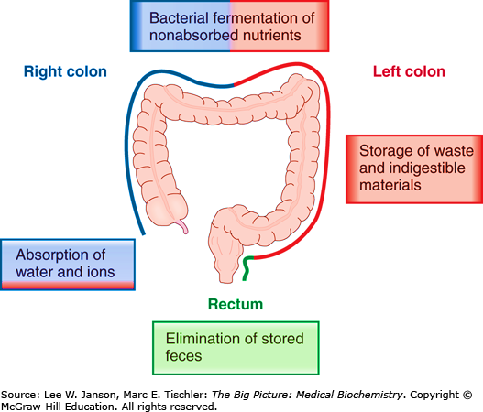
University of Basrah Al-zahraa medical college
Ministry of higher Education and Scientific Research
Functions of large intestine:
1- To finish absorption of nutrients and water.
2- Synthesize certain vitamins (K, B complex).
3- Form, storage and eliminate feces from the body.
LO6

Slide 32
University of Basrah Al-zahraa medical college
Ministry of higher Education and Scientific Research
Motility patterns of the colon and rectum
LO7
three types of movements.
1- Haustral contraction: sluggish segmentation
Primarily in the transverse and descending colons.
as the circular muscles are more complete than the longitudinal, which have been reduced to the taenia coli.
These movements push and mix the food residue, which helps the large intestine absorb water.
2- Peristalsis: is slower than in the more proximal portions of the alimentary canal.

Slide 33
University of Basrah Al-zahraa medical college
Ministry of higher Education and Scientific Research
3-mass movement: strong waves
Start midway through the transverse colon and quickly force the contents toward the rectum.
Usually occur Once or twice a day.
Forces faeces rapidly into the rectum which is normally empty. The resulting distension produces the urge to defaecate.
LO7
Distension in the stomach and the chyme in the small intestine provoke the gastrocolic reflex, which increases colonic motility, including mass movements.
Fibers in the diet both softens the stool and increases the power of colonic contractions.

Slide 34
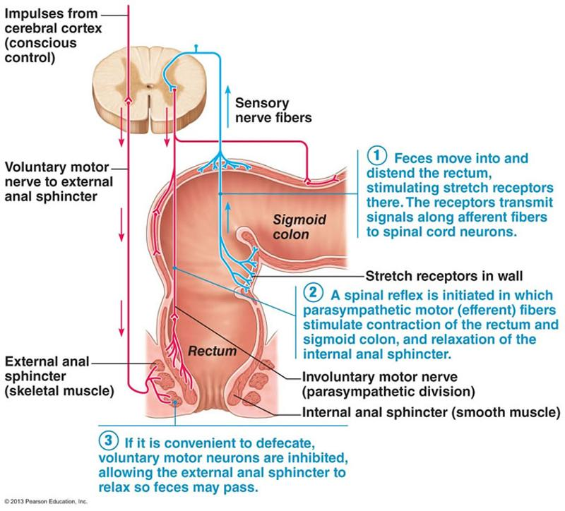
University of Basrah Al-zahraa medical college
Ministry of higher Education and Scientific Research
Mechanisms of Defecation
LO8
Pudendal nerve

Slide 35
University of Basrah Al-zahraa medical college
Ministry of higher Education and Scientific Research
LO8
Feces are eliminated through contractions of the rectal muscles.
This process is helped by a voluntary procedure called Valsalva’s maneuver??
Increase intra-abdominal pressure by contracting the diaphragm and abdominal wall muscles, and closing the glottis.

Slide 36
University of Basrah Al-zahraa medical college
Ministry of higher Education and Scientific Research
LO8
If defecation is not initiated voluntarily, sacral reflexes will eventually trigger it involuntarily as rectal pressure rises.
The number of bowel movements varies greatly between individuals, ranging from 2-3 per day to
3 - 4 per week.

Slide 37
University of Basrah Al-zahraa medical college
Ministry of higher Education and Scientific Research
THANK YOU

